Slide 1
Year 4 Times Table Check
18 things to think about…

Slide 2
What Is The Purpose Of The Multiplication Tables Check?
Here’s what the framework tells us:
The purpose of the MTC is to determine whether year 4 pupils can fluently recall their multiplication tables. Although the check will help schools to identify pupils who require additional support, it is not intended as a diagnostic tool.

Slide 3
Who Will Take the Multiplication Tables Check?
Everyone in Year 4 will take the check.

Slide 4
Now, let’s look over 16 key facts about the Multiplication Tables Check

Slide 5
1: It Will Only Present Children With Multiplication Statements Not Division
It’s been confirmed that Year 4 children will only face multiplication statements in the check. This means that related division facts, whilst a key part of children’s mathematical learning, will not be tested as part of the check.

Slide 6
2: The Times Tables Check Is Online And On-Screen
It’s been confirmed that test will be fully digital and take place on screen.
It will be available to use on laptops, desktops and tablets.

Slide 7
3: The Check Will Take Place In June Each Year
There will be 3-week window in June for the administration of the check.
There is no set test day, nor an expectation that all children will take the check at the same time.

Slide 8
4: Children Can Practise Before Taking The Check
Before the test window opens each year, there will be the opportunity for children to access a practice area to become familiar with the style of the KS2 times tables test.
We have begun using Times Tables Rockstars today!

Slide 9
5: It’ll Take Less Than 5 Minutes Per Pupil
Under standard administration (i.e. without any access arrangements) the multiplication check will take less than 5 minutes per pupil.
There is no requirement for all children in a class to take the check all at once.

Slide 10
6: Children Will Have 6 Seconds To Answer Each Question
Children will get 6 seconds from the time the question appears to input their answer. This means that children must be able to read, recall and enter their response within 6 seconds.
They will enter their answer using a keyboard or by pressing digits using a mouse or touchscreen on an on-screen number pad.
This means that it is vital that children are able to rapidly recall multiplication facts, and can do so ‘out of sequence’ (i.e. answer 6 x 7 without having to count in 6’s from 0).
Whilst it may be tempting to resort to ‘rote learning’ for the multiplication tables, it is important that this is avoided, as it leads to children simply being able to chant facts without any meaning, and reduces their ability to recall facts out of sequence.

Slide 11
7: Whatever Is In The Answer Box At The End Of The 6 Seconds Will Be Counted As The Answer
This means that if a child is mid-way into entering a two digit answer (e.g. they only enter the 7 out of 72 when answering 8 x 9) they will be recorded as having answered 8 x 9 as 7.

Slide 12
8: Children Will Face 25 Questions
Children will be presented with 25 questions. There will be a 3 second pause in-between each question, before the next question appears on screen. It is therefore important that children have been used to answering (at least) 25 questions in quick succession before they face the test.
Each child will be randomly assigned a set of questions, which the STA refer to as a ‘form’. This is the spread of questions.

Slide 13
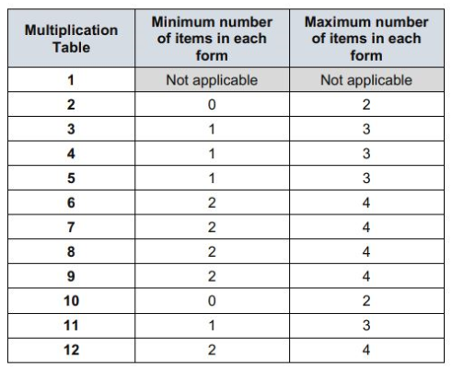
9: There Will Not Be An Equal Spread Of Each Multiplication Table Within The Check
The check has been designed to focus on times tables that fit within the KS2 curriculum.
The 6, 7, 8, 9 and 12 times tables are more likely to be asked than the 2, 3, 4, 5, 10 or 11 multiplication tables. The STA state that there is a focus on these as these are the ‘most difficult’ multiplication tables.

Slide 14
10: 6 x 3 Is ‘6, Three Times’
The STA state that they are classifying the multiplication tables by the first number in the question. For example, 8 x 3 would fall within the 8 times table.

Slide 15
11: Remember, Commutativity Is Really Important
Of course, it is important that children understand the commutative property of multiplication, and that 8 x 3 (8, three times) is the same as 3 x 8 (3, eight times.)

Slide 16
12: Eleven Facts Are More Likely To Appear Than Others
This means that the following 11 multiplication questions (and their commutative equivalents) are more likely to be asked: –
• 6 x 6, 6 x 7, 6 x 8, 6 x 9, 6 x 12
• 7 x 8, 7 x 9, 7 x 12
• 8 x 9, 8 x 12
• 12 x 12

Slide 17
13: There Is No ‘Pass’ Rate Or Threshold
The guidance is clear that there is no expected pass rate or threshold. This means that, unlike the KS1 Phonics Screening check, children will not be expected to re-sit the check if they do not meet a set threshold in this KS2 Times Tables Test.
BUT…

Slide 18
14: National And Local Authority Results Will Also Be Published
From 2020, the DfE will report on the performance of pupils in the check nationally and in each local authority.
There is no guidance at this point as to what form these reports will take, but we can infer from the test framework that is likely to include the percentage of children who achieve full marks.

Slide 19
15: Results Will Not Be Published In Performance Tables
The document clarified that results of the check will not be published in the publicly accessible school performance tables.
We also know from previous information released about the test that there are no current plans to use the results from the multiplication check in judging if schools meet the ‘floor standard’.
BUT…

Slide 20
16: Results Will Be Reported And Analysed- Including By Ofsted
From 2020, school and individual pupil-level reports will be made available to schools- in a similar way to the results from the KS1 Phonics Check are reported.
This will mean that schools can target support and intervention where needed.

Slide 21
So there you have it…
Any questions?

