Slide 1
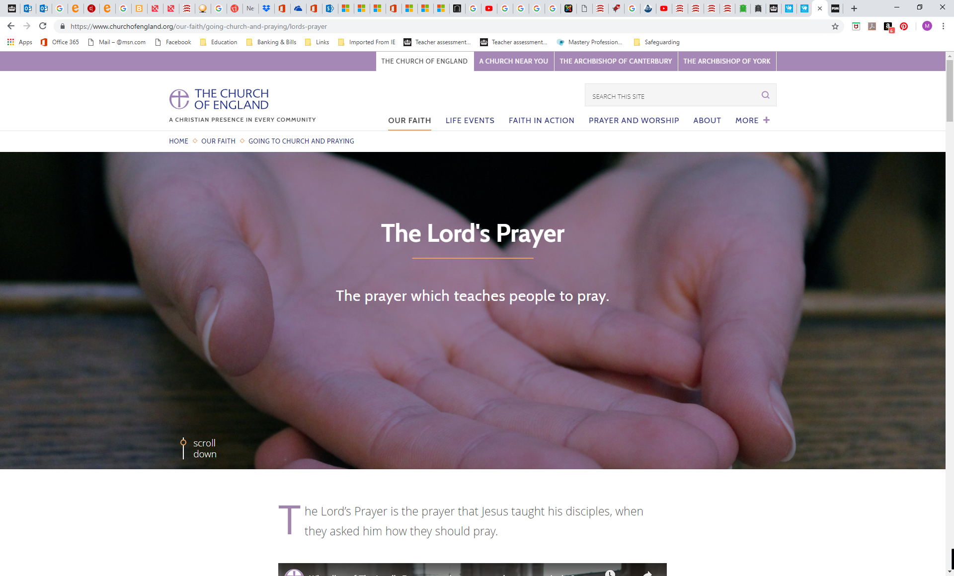
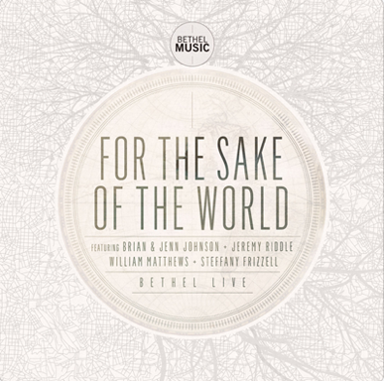

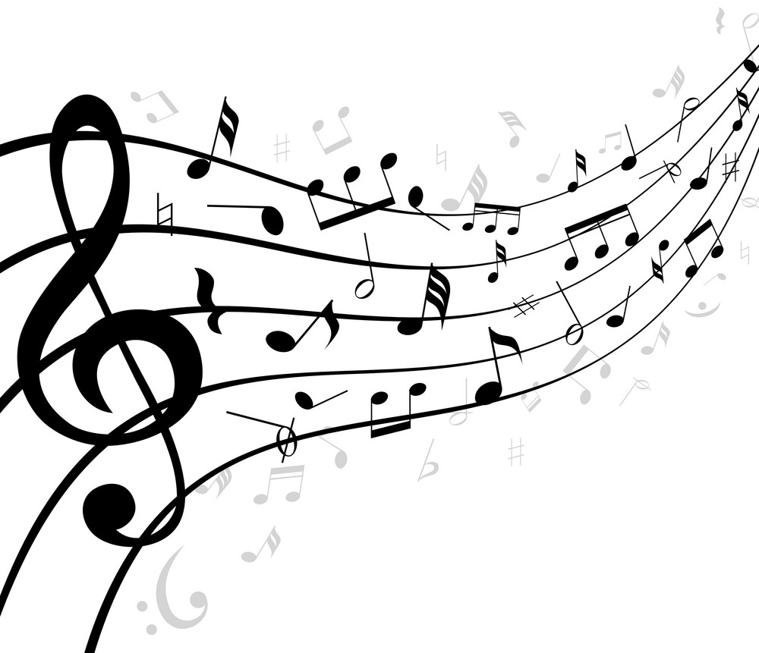
https://www.churchofengland.org/our-faith/going-church-and-praying/lords-prayer
Our Father
Jenn Johnson
Notes:
Play during the children coming in.

Slide 2
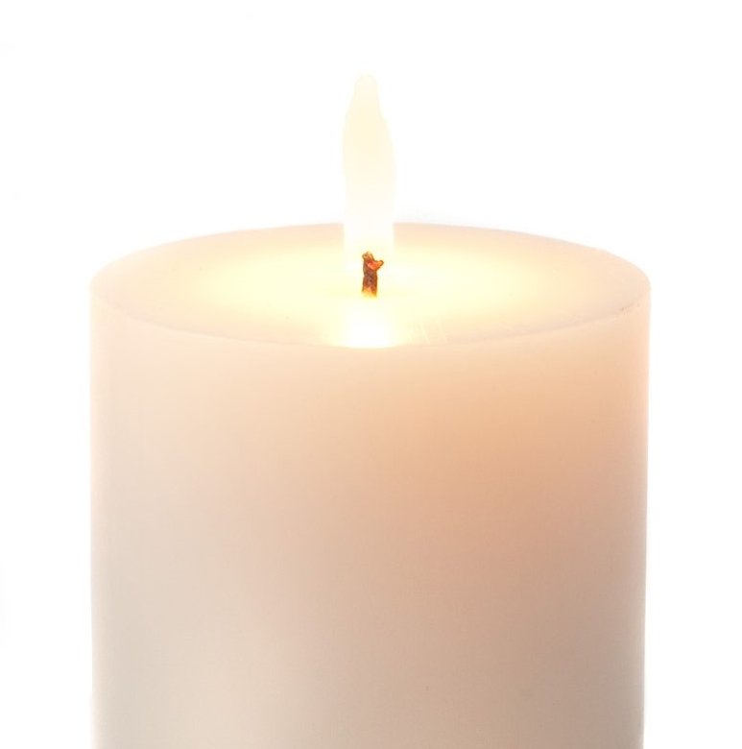
Gather
Lord, you are the faithful guide of those who seek you with a pure heart:
make known your glory.

Slide 3
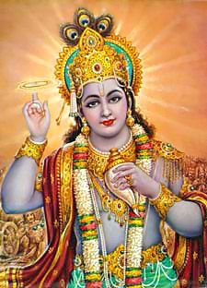
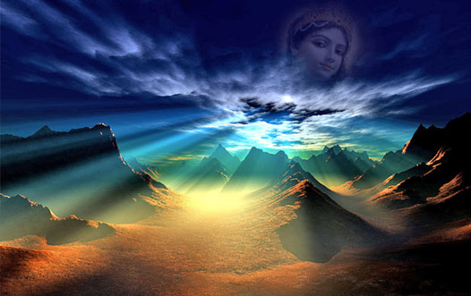
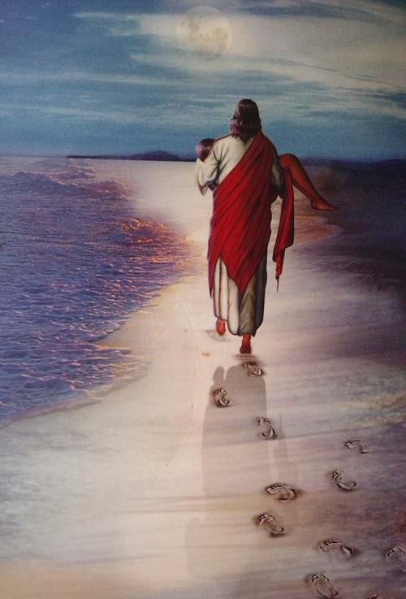
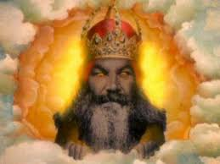
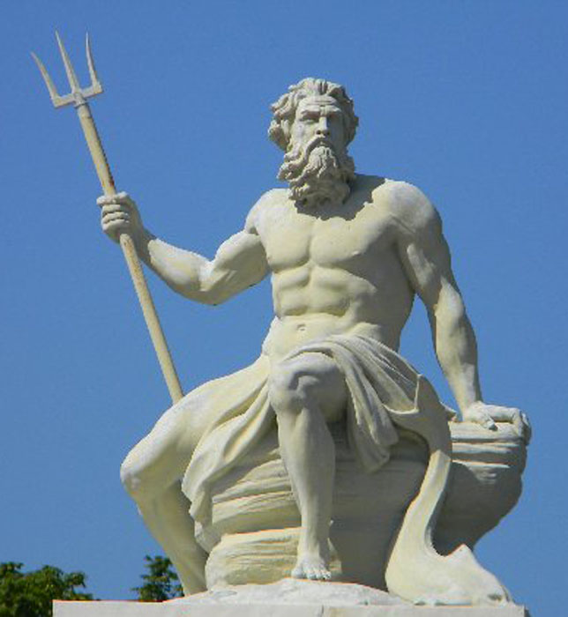
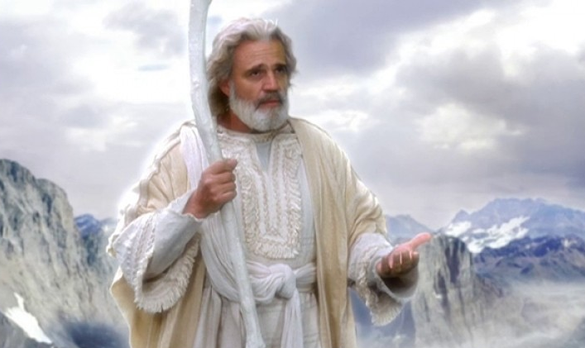
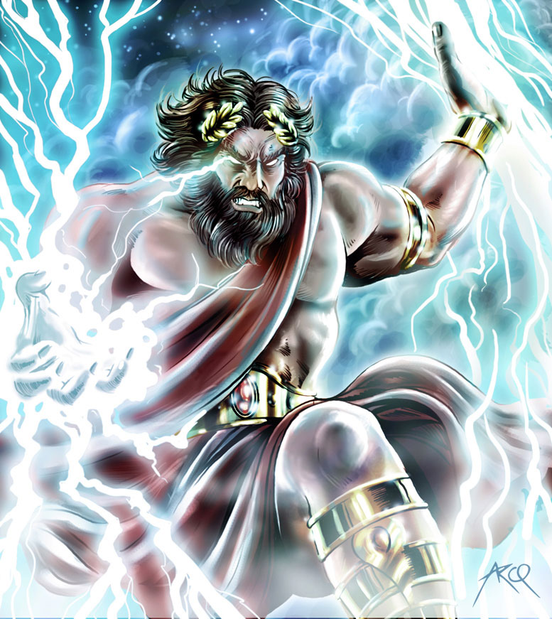
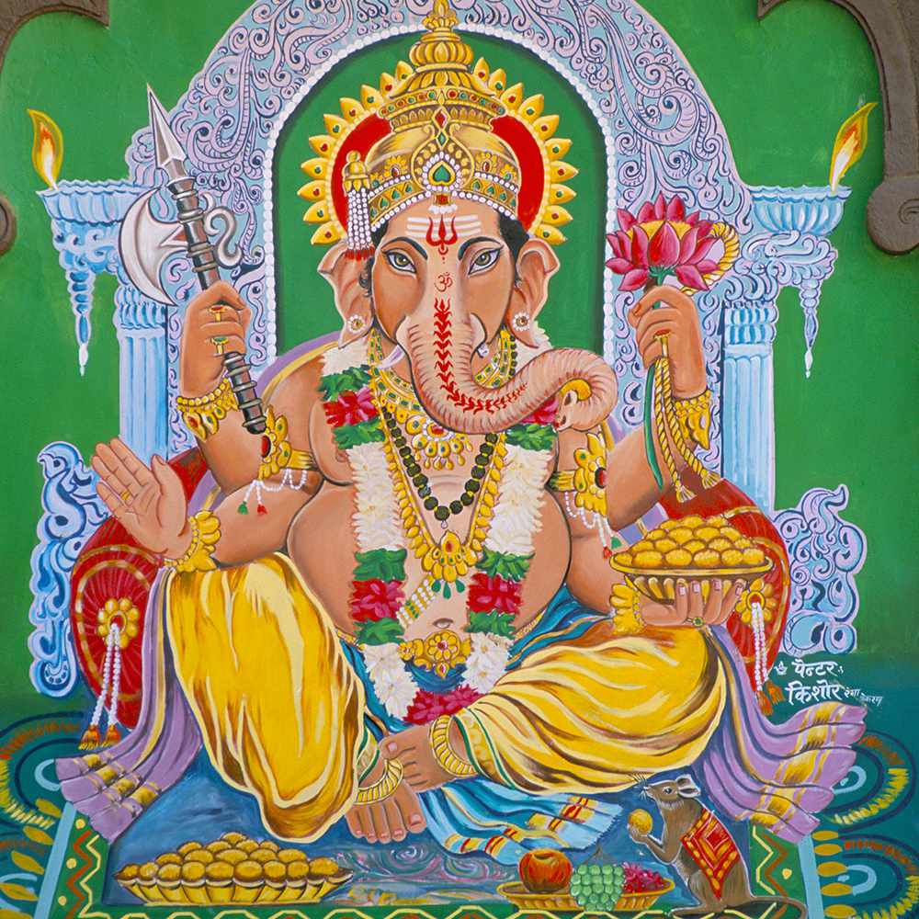
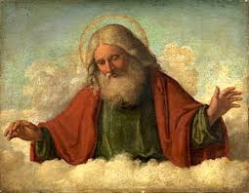
God
God
Notes:
Last week we talked about Who God is.
…
This week we will look at how we talk to him and what that shows about Christian faith in him.

Slide 4
“ ”
Talking to God
Most Christians know the prayer by heart in their own language. There are some changes in wording of certain prayers but it is used today by every Christian tradition. Every Anglican act of worship contains some sort of prayer. A pattern for prayer might be:
  We bless God and pray for our world, our communities and our lives to be shaped by God’s will;
  We pray for daily needs to be met,
  For forgiveness for wrongdoings, strength to resist temptation and protection from danger.

Slide 5
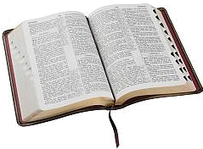
Origins
The text is found in two slightly different versions in the New Testament – Matthew 6.9–13 and Luke 11.1–4
LUKE 11.1-4
Jesus was praying in a certain place, and after he had finished, one of his disciples said to him, ‘Lord, teach us to pray, as John taught his disciples.’ He said to them, ‘When you pray, say:
Father, hallowed be your name.
Your kingdom come.
Give us each day our daily bread.
And forgive us our sins,
for we ourselves forgive everyone indebted to us.
And do not bring us to the time of trial.
Notes:
Origin – what does that word mean?
RECORD ON PAPER FOR VOCAB

Slide 6

Traditional
Our Father, who art in heaven,
Notre Père qui es aux cieux:
Contemporary
Our Father in heaven,
Notes:
Lets have a look at the meaning behind the different parts of the prayer.

Slide 7
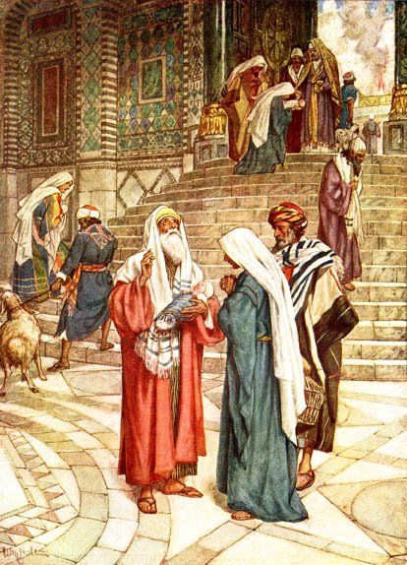
Traditional
Our Father,
Notre Père
Contemporary
Our Father
Notes:
In Jesus’ time the people we lead by the Rabbi. These men where leaders of the Jewish faith (Jesus was a Jew).
The role of the Rabbi was to lead his people and make sure that the laws of God were being followed (10 commandments). Children were take to the Rabbi at the temple when they were born to be welcomed into the Jewish faith and family.

Slide 8

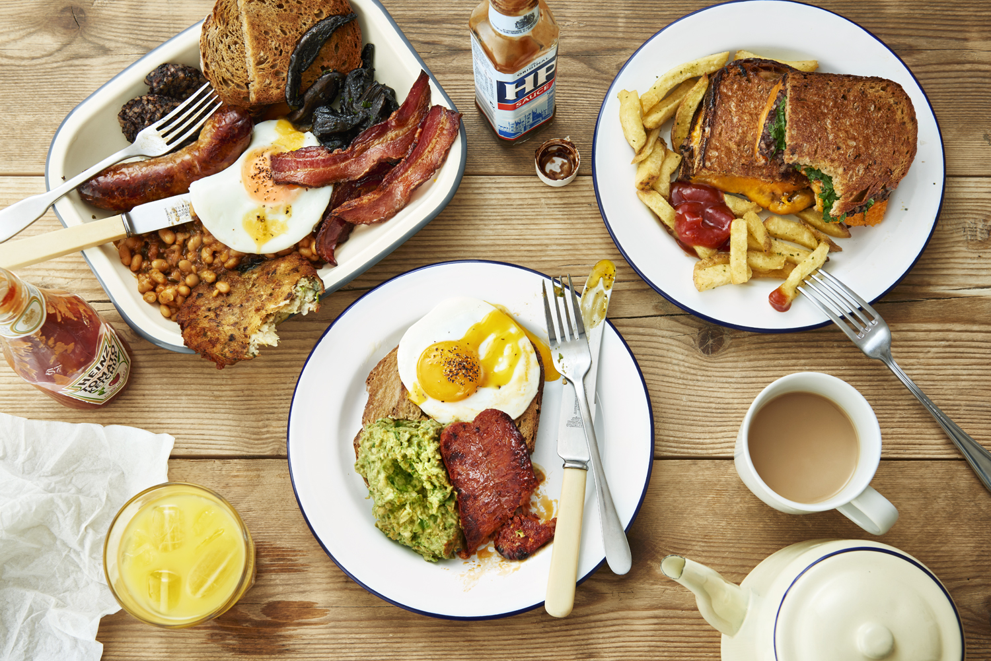

Traditional
Our Father,
Notre Père
Contemporary
Our Father
Notes:
Alongside this men were the family members with a job; they brought home the money that would keep the family with food and clothing. Therefore they provided for the family.
It was understood that God looked after us and gave us what we needed therefore he was like a father figure.

Slide 9
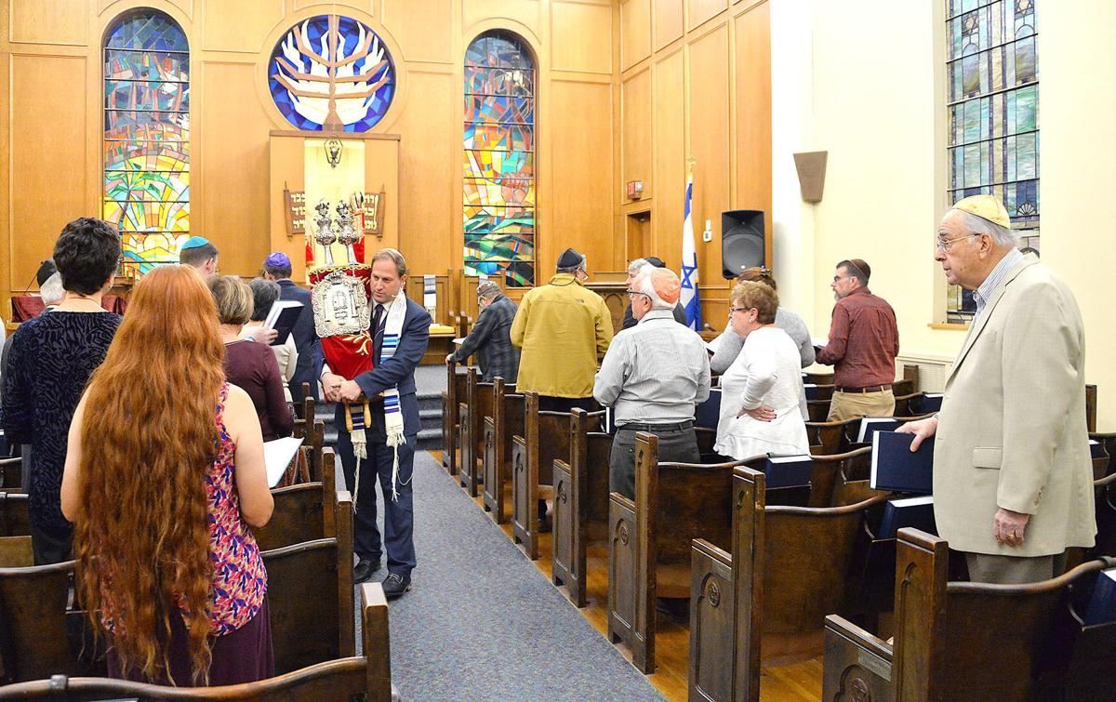
Traditional
Our Father,
Notre Père
Contemporary
Our Father
Notes:
The Jewish faith still has rabbi who lead their acts of worship. Who do you think he is?
Is it still always the men with the power and the responsibility?

Slide 10
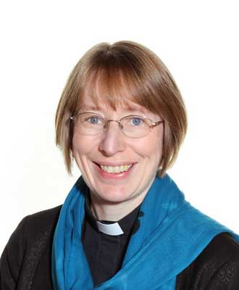
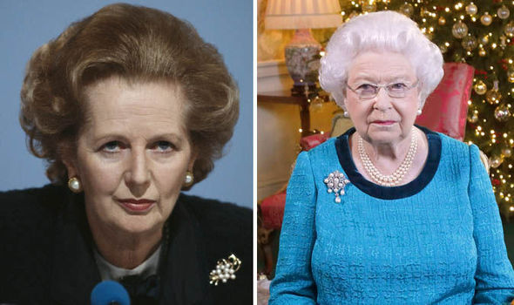
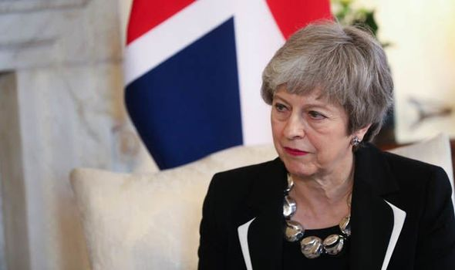
Traditional
Our Father,
Notre Père
Contemporary
Our Father

Slide 11
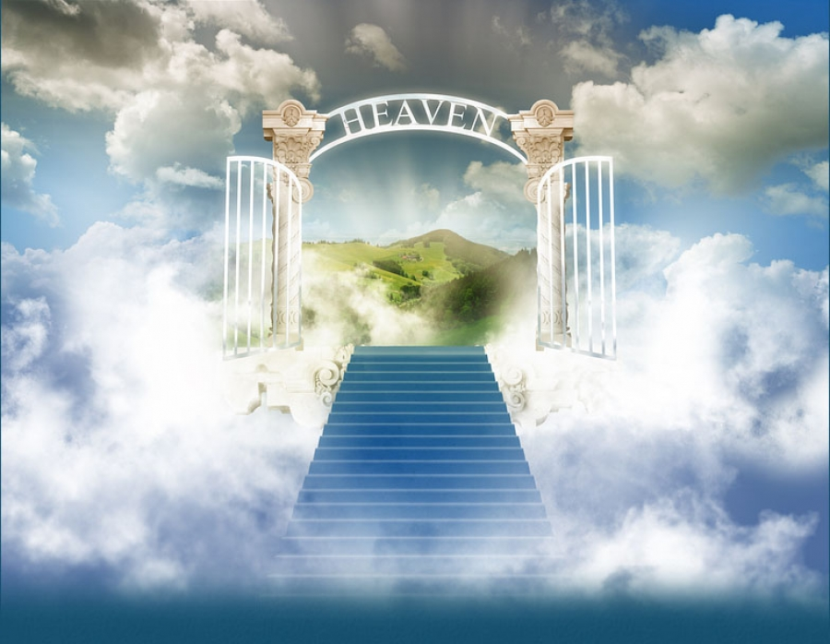
Traditional
Our Father, who art in heaven,
Notre Père qui es aux cieux:
Contemporary
Our Father in heaven,
Notes:
What is heaven?
DISCUSSION – record ideas on whiteboard
Ultimately no one knows what heave is. As Christians believe heaven is where you go when you die to be with God. Some people talk about it being up in the sky other say it is all around us. It isn’t somewhere we can get to while we are alive even in a plane!

Slide 12
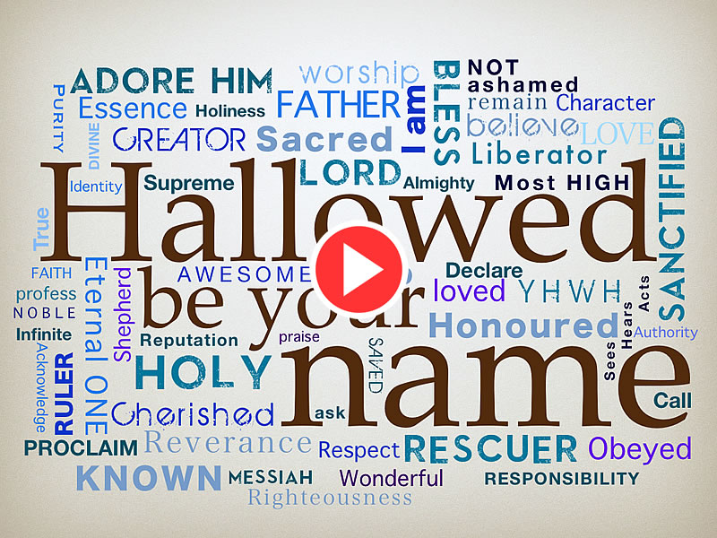
Traditional
hallowed be thy name;
que ton nom soit sanctifié;
Contemporary
hallowed be your name,
Notes:
Hallowed means made holy or consecrated. How do Christian make names holy or special?

Slide 13
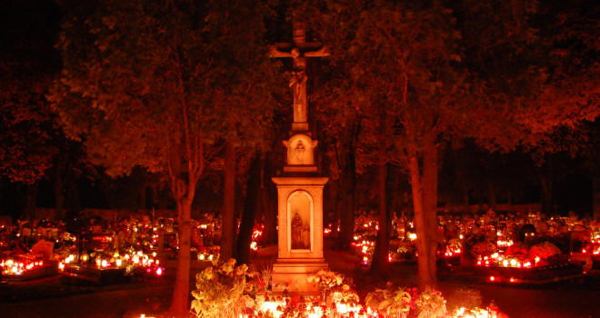
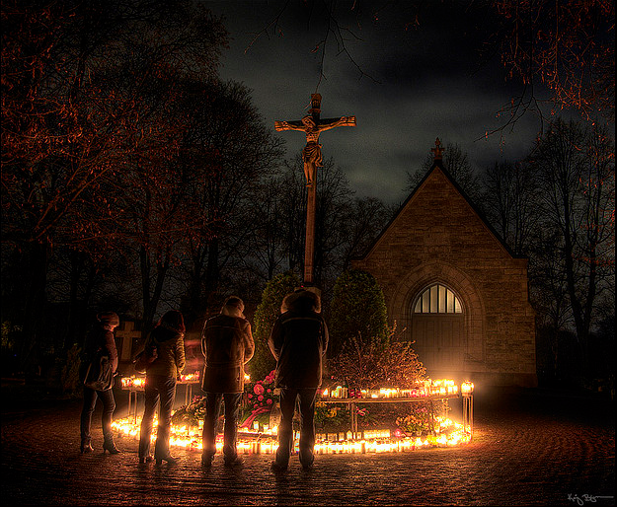
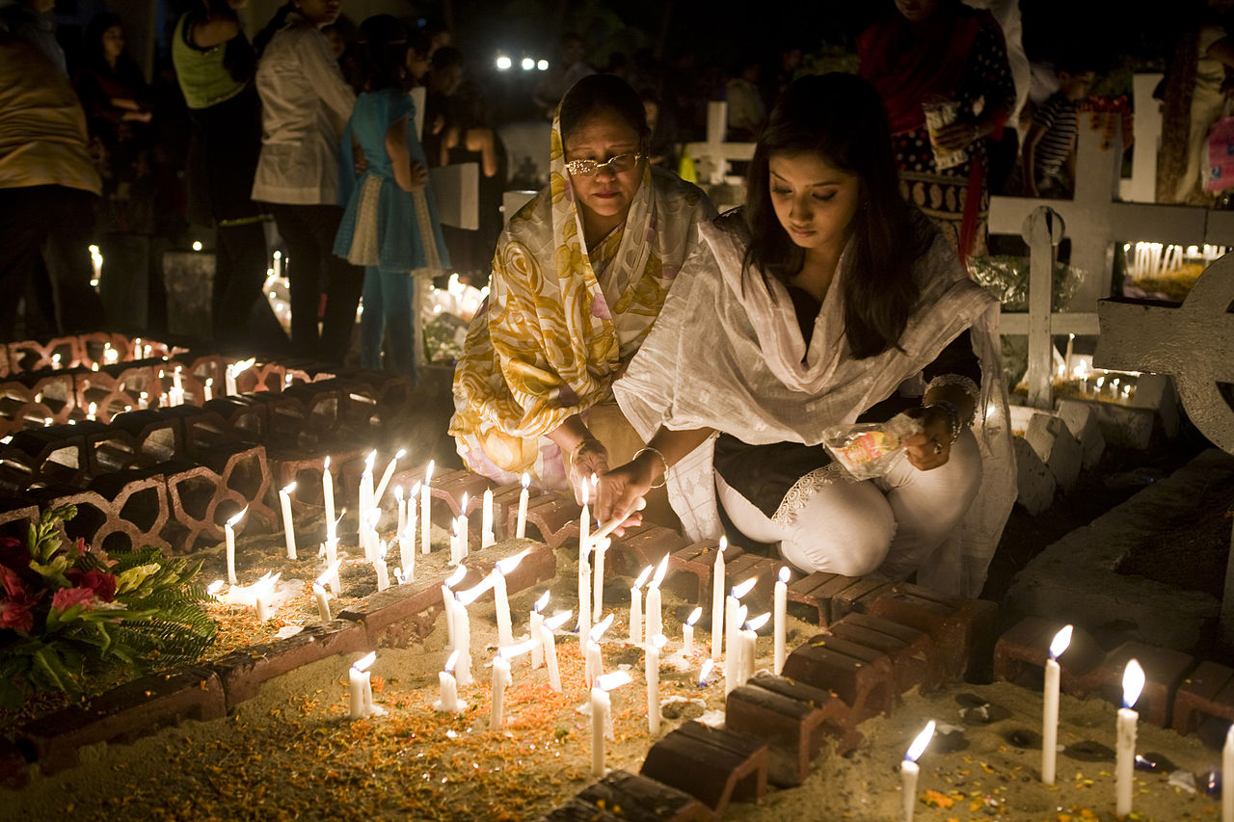
Traditional
hallowed be thy name;
que ton nom soit sanctifié;
Contemporary
hallowed be your name,
Notes:
All Hallows Day is all saints day. A Christian festival in lots of countries where they celebrate the saints.

Slide 14
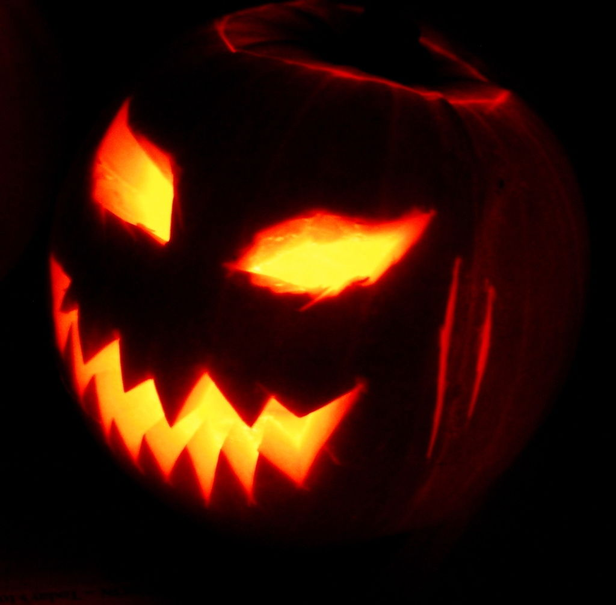
Traditional
hallowed be thy name;
que ton nom soit sanctifié;
Contemporary
hallowed be your name,
Notes:
Halloween or Hallowe’en is a contradiction of this celebration where people think about ghosts and ghouls. This happens on the night before All Saints Day.

Slide 15
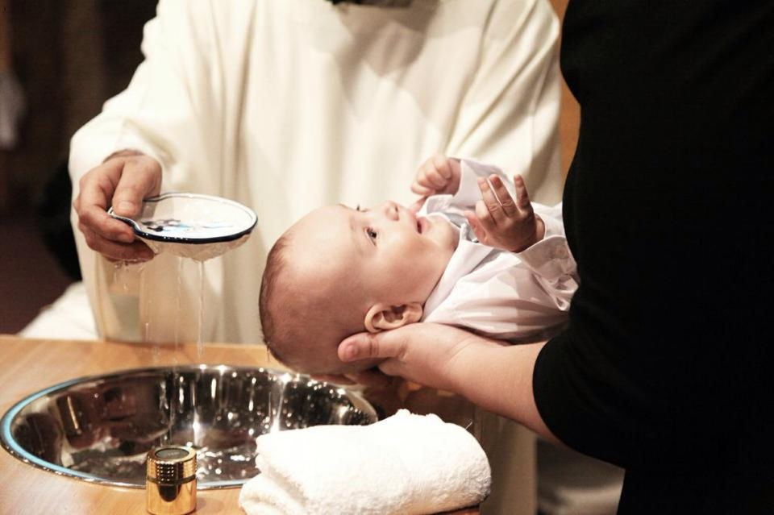
Traditional
hallowed be thy name;
que ton nom soit sanctifié;
Contemporary
hallowed be your name,
Notes:
Hallowed means made holy or consecrated. How do Christian make names holy or special?
Knowing someone's name is the first step to knowing them we need to know God’s name to know him.

Slide 16
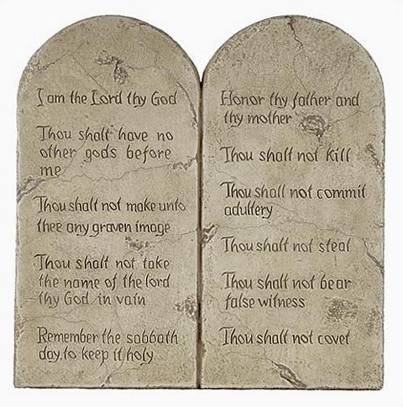
Traditional
hallowed be thy name;
que ton nom soit sanctifié;
Thou shalt not take the name of the Lord thy God in vain.
Contemporary
hallowed be your name,
Notes:
10 commandments
Name are important. Lot of faith believe names hold power and people used to believe that witches could cast spells on you if they knew your full name.

Slide 17
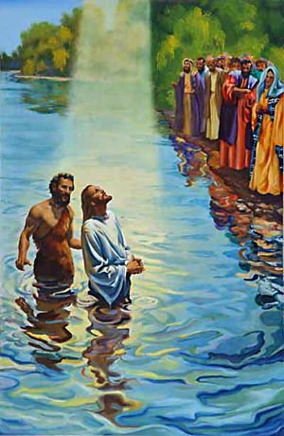
Traditional
thy kingdom come;
que ton règne vienne;
Mark - Jesus Announces the Good News
¹⁴ After John was put in prison, Jesus went into Galilee, proclaiming the good news of God. ¹⁵ “The time has come,” he said. “The kingdom of God has come near. Repent and believe the good news!”
Contemporary
your kingdom come,
Notes:
Mark’s gospel was written for people who didn’t know about Jesus or his culture (Gentiles). He starts his gospel with the opening sentence declaring Jesus Christ the Son of God,
God the Father and the Holy Spirit appear as early as 1:9-11, during the Baptism of Jesus in the River Jordan by John the Baptist!
Jesus announces the Kingdom of God in Mark 1:15
This was the fulfilment of a promise (covenant) made by God to his people that he would send his son to save the world. The good news is that Jesus is the son of god and that the kingdom of god is coming (heaven).

Slide 18
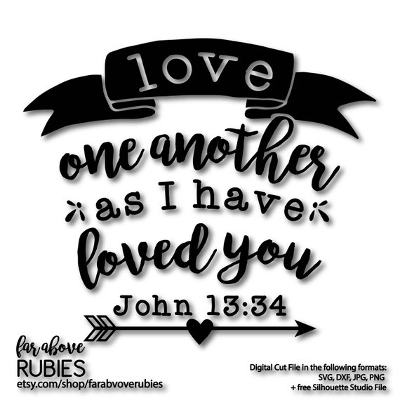
Traditional
thy will be done;
on earth as it is in heaven.
que ta volonté soit faite
sur la terre comme au ciel.
Contemporary
your will be done,
on earth as in heaven.
Notes:
What does God want to happen? …. This is gods will.
Where does he want it to happen?

Slide 19
Send
Bless and keep all your people.
Hear us, good Lord.

Slide 20
Class Worship
Recap parts with the children to check understanding.
Explore who looks after them and how
Explore what they think about heaven
Explore God’s promise to us
How do we show God’s will?

Slide 21
Our Father in heaven,
hallowed be your name,
your kingdom come,
your will be done,
on earth as in heaven.
Give us today our daily bread.
Forgive us our sins
as we forgive those who sin against us.
Lead us not into temptation
but deliver us from evil.
For the kingdom, the power,
and the glory are yours
now and for ever.
Amen.
Notre Père qui es aux cieux:
que ton nom soit sanctifié;
que ton règne vienne;
que ta volonté soit faite
sur la terre comme au ciel.
Donne-nous aujourd'hui notre pain quotidien;
et pardonne-nous nos offenses,
comme nous pardonnons à ceux qui nous ont offensés;
et ne nous induis point en tentation,
mais délivre-nous du mal.
Amen!

