Slide 1
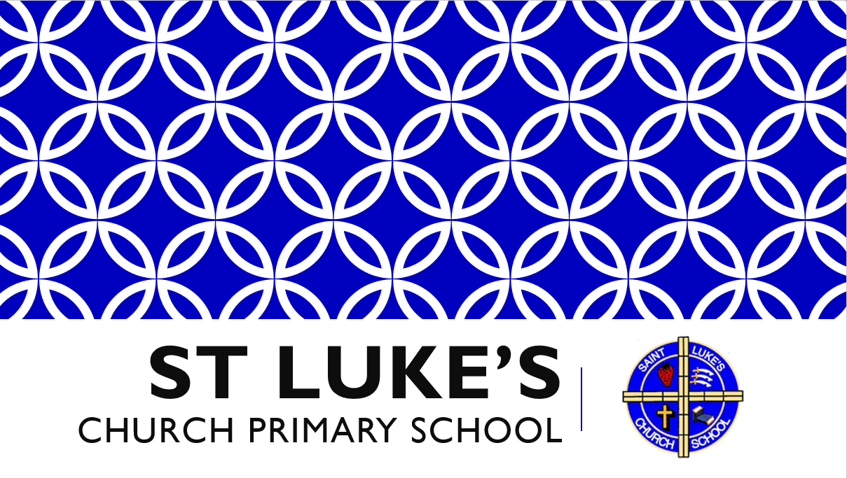

Slide 2

Gather
Lord, you are the faithful guide of those who seek you with a pure heart:
make known your glory.

Slide 3
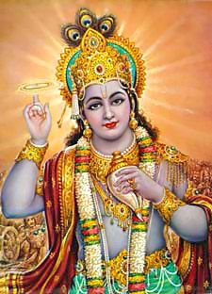
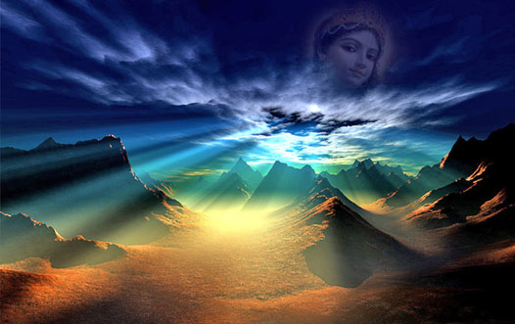
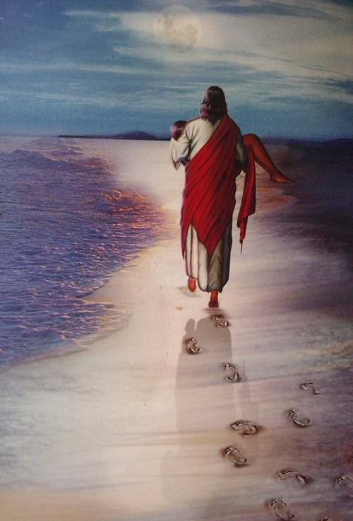
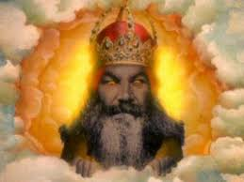
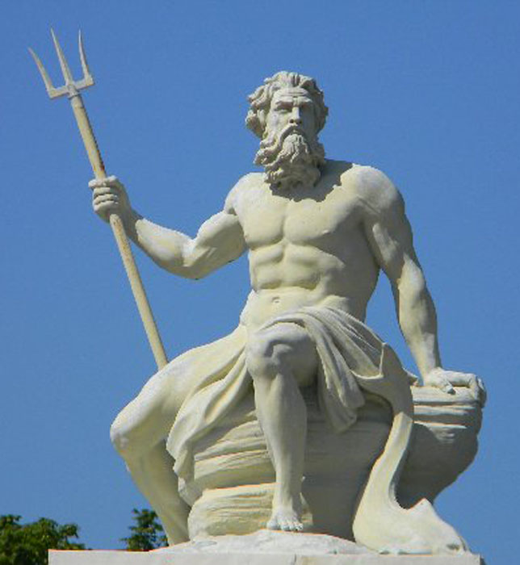
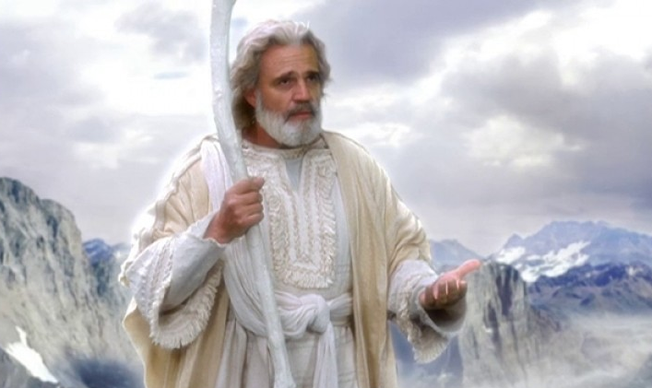
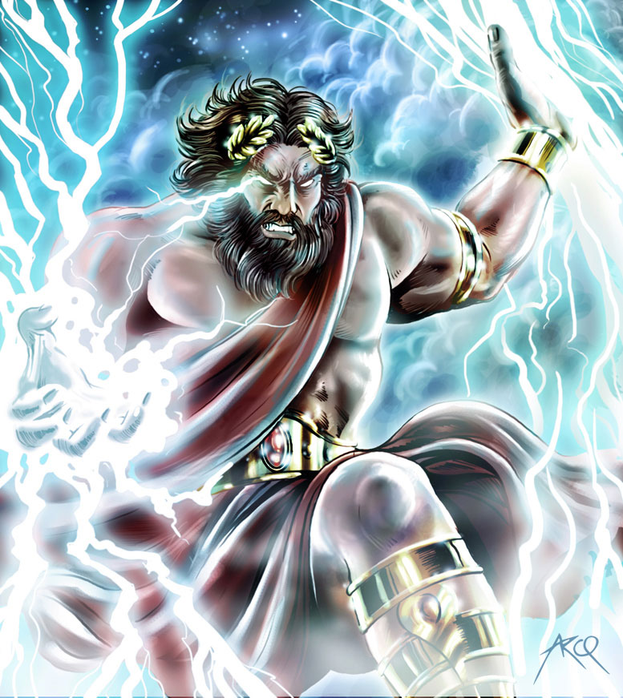
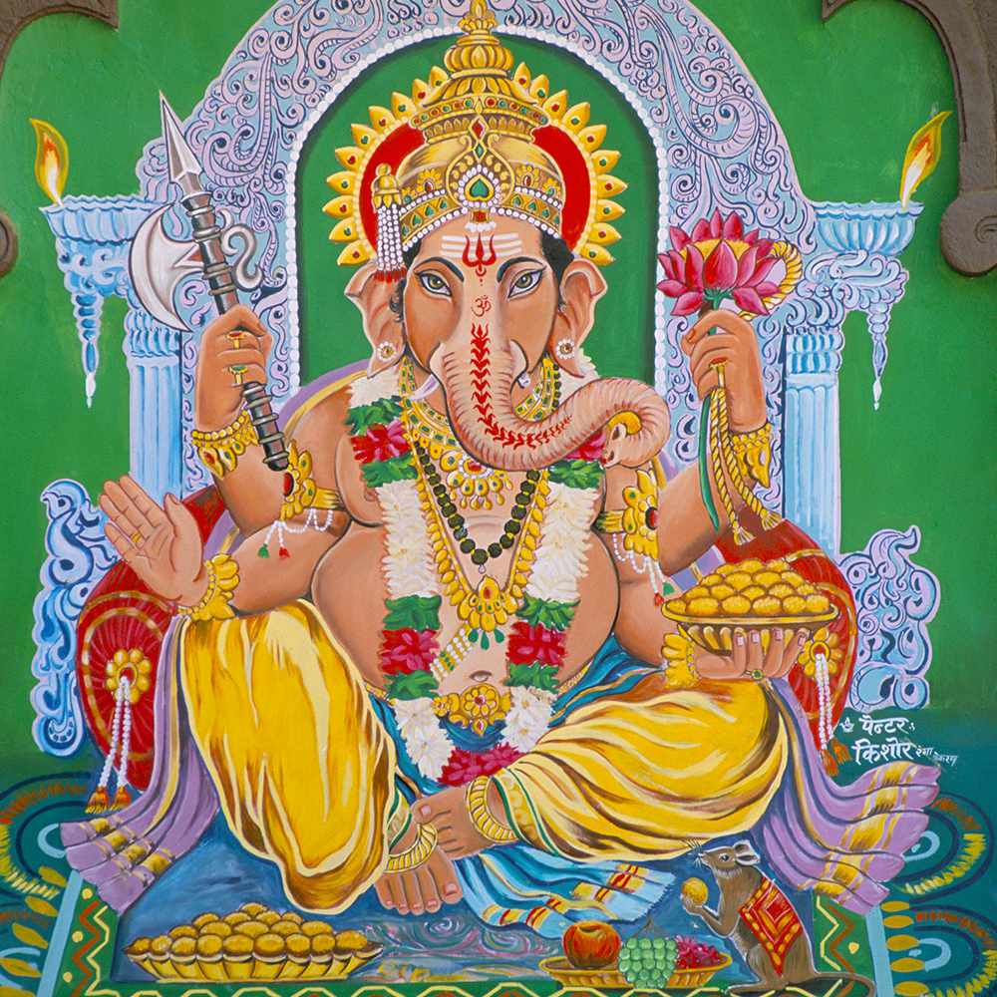
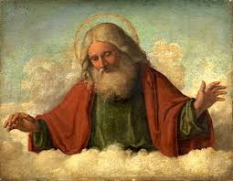
God or
Have a look at the different pictures before thinking about the questions on the next slide.
gods

Slide 4
LIKES – What did you like about the images or ideas? What did you find interesting? Why did you think it was effective? | DISLIKES – What did you not like about the images or ideas? What did you find dull or uninteresting? What made this image or idea uninteresting or difficult to understand?
PATTERNS – What images or ideas are like each other? Were there any similarities that you saw in different images? Are there any patterns in how colours or settings are used? | PUZZLES – What questions would you like to ask one of these interpretations of gods?

Slide 5
God or
Likes
Dislikes
Patterns
Puzzles
gods
Use the questions on the last slide to help you.
What other pictures can you find?

Slide 6
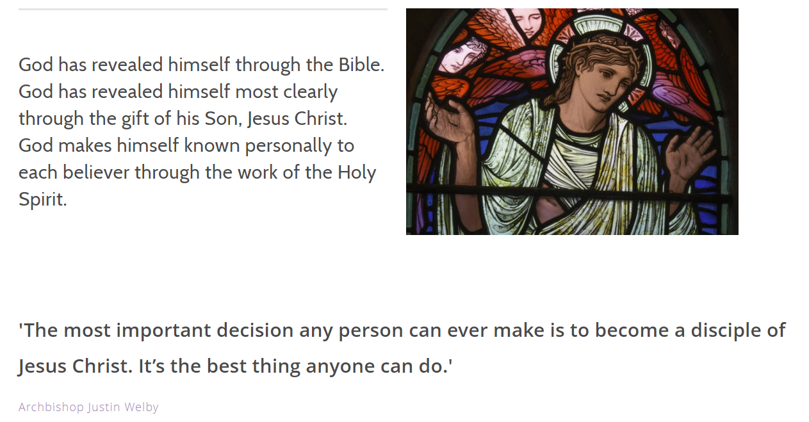

Slide 7
The Trinity
God the Father,
God the Son,
God the Holy Spirit

Slide 8
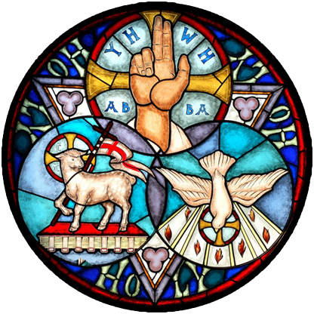
Christians believe in the idea of trinity that God is one but with three separate parts.
Look at the picture.
It is one stain glass window but has different parts what can you see?
Do you know any stories that have any of the objects in them?

Slide 9
God the Father,
Creator of Heaven and Earth
Creator of us all
God the Holy Spirit,
The giver of life
Dove
Tongues of flame
Spoken through the prophets and disciples
God the Son,
Jesus Christ,
God incarnate (made human),
The only Son of God
The Lamb who was sacrificed for us,
The good Shepherd,
Rose from the dead in fulfilment of God’s promise,
Born of the Virgin Mary,
The Trinity

Slide 10
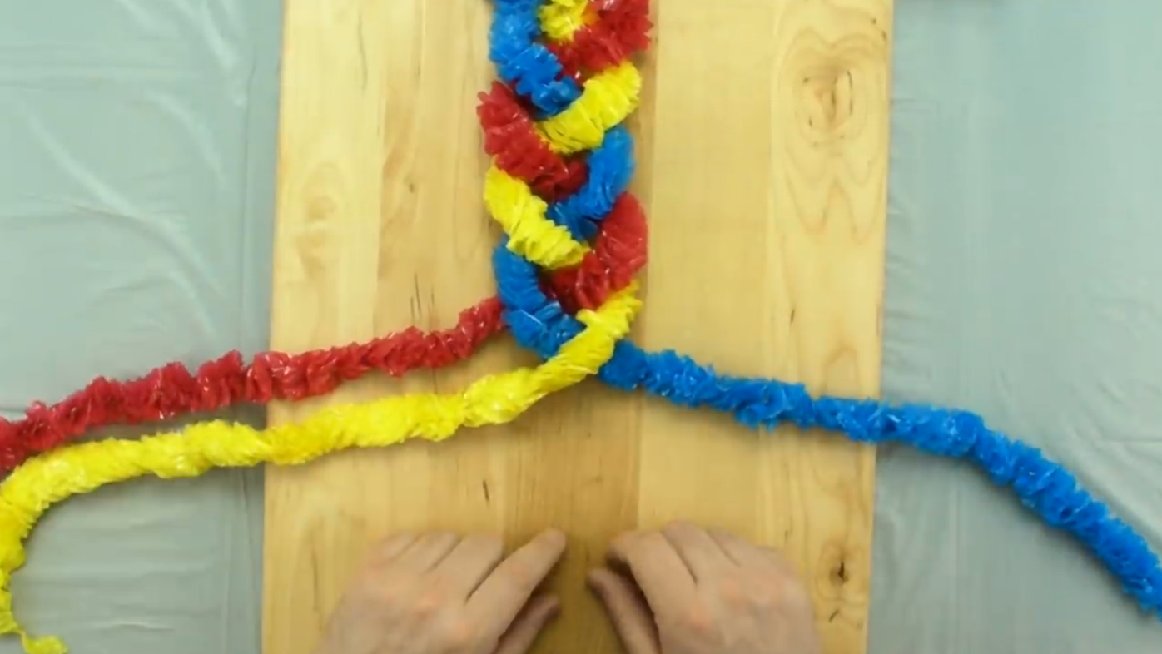
Watch the video on the next page.
You will need to click on the play button.
In the video it shows how to plait three different colours together into one piece.
While you are watching think about how this links to what we understand so far about God.

Slide 11
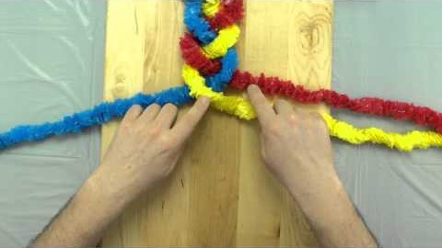
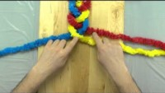

Slide 12
Send
Bless and keep all your people.
Hear us, good Lord.

